Slide 1
Chapter-4
Data Preprocessing

Slide 2
Why Data Preprocessing?
Data which do not have the required quality has the effect of bad quality mining results!
Quality decisions must be based on quality data
Quality data is key for success in data warehousing and data mining

Slide 3
Why Data Preprocessing?
Data in the real world is full of dirty
  incomplete:
    lacking attribute values that is vital for decision making so they have to be added,
    lacking certain attributes of interest in certain dimension and should be again added with the required value,
    containing only aggregate data so that the primary source of the aggregation should be included
  noisy: containing errors or outliers that deviate from the expected
  inconsistent: containing discrepancies in codes or names of the organization or domain
  etc

Slide 4
Why Data Preprocessing?
Incomplete, noisy and inconsistent data are commonplace properties of large real world databases and data sources
Data cleaning routine work to clean such problems so that results can be accepted
Before starting data preprocessing, it will be adviceable to have overall picture of the data we have so that it tell as high level summary such as
  General property of the data
  Which data values should be considered as noise or outliers
This can be done with the help of descriptive data summarization

Slide 5
Descriptive data summarization
Descriptive summary about data can be generated with the help of measure of central tendency of the data and dispersion of the data
Measure of central tendency includes
  Mean
  Median
  Mode
  Mid-Range
Measure of dispersion includes
  range
  The five number summary (based on Quartiles)
  Interquartile range (IQR)
  Standard deviation

Slide 6

Descriptive data summarization
Mean
Appropriate for data distributed normally
Mean is the most important quantity for describing dataset but it is sensitive to extreme values of an attribute (example outliers)
So we should consider options
  Trim extremely large and small value (may be 2% from each side)
  Consider another central tendency measure

Slide 7

Descriptive data summarization
Median
  Appropriate for skewed (asymmetric) data
  However, it is holistic function and difficult to compute
  There are heuristics used to estimate median by grouping the data into groups of equal width intervals and assume the median is in the median of the intervals
  Let the median interval has lowest value l, the number of values in the entire data set is N, the total number of data in all intervals bellow the median interval is F, the frequency of data in the median interval is f, and w is the width of the median interval then median can be estimated as

Slide 8

Descriptive data summarization
Measure of central tendency includes
  Mode
    Is the set of data that occur most frequently
    Data can be uni-modal, bimodal, tri-modal or multimodal in general
    It tells the most frequent data points
    Is holistic function
    For uni-modal data that is moderately skewed, the mode can be estimated as
  Mid range
    Is the average of the largest and smallest values in the set
    Is an algebraic function computed as

Slide 9
Descriptive data summarization
Measure of dispersion (Variance) includes
  range
  The five number summary (based on Quartiles)
  Interquartile range (IQR)
  Standard deviation
Boxplot can be plotted based on the five number summary and are useful tool for identifying outliers

Slide 10
Descriptive data summarization
Range
  Is the difference between the maximum and the minimum values
  We can assume the data is sorted in ascending for analyzing the other values
  Hence range is the first value subtracted from last value
  The data bellow has range of 455
1, 3, 4, 4, 12, 19,
23, 34, 43, 45, 45, 56,
56, 56, 56, 65, 67, 76,
78, 78, 86, 250, 456

Slide 11
Descriptive data summarization
Quartiles
  The K^{th} percentile of a set of data in numerical order is the value x_{i} having the property that K% of the data entries lie at or bellow x_{i}
  Median is the 50th percentile
  Important percentile is quartiles
    1st quartile refers to 25th percentile (Q₁)
    2nd quartile refers to 50th percentile (median) (Q₂)
    3rd quartile refers to 75th percentile (Q₃)

Slide 12
Descriptive data summarization
Inter Quartile Range
  The Inter-Quartile Range refers to the difference between the third and the first quartile(i.e. IQR = Q₃- Q₁)
  Q₁, median, Q₃, IQR are all holistic functions
  For the above data
    Q₁ = 19 Q₂ = 56 Q₃ = 76 IQR = 57

Slide 13
Descriptive data summarization
The five number summary (based on Quartiles)
  Includes the parameters: the minimum, Q₁, median (Q₂), Q₃, IQR, and maximum
  The quartiles including the median gives some indication of the center, spread, and shape of the distribution
  A common rule of thumb for identifying suspected outliers are values greater than Q₃ + 1.5IQR and bellow Q₁-1.5IQR
  For the above data
    Q₃ + 1.5*IQR = 165.6 and
    Q₁-1.5IQR = -66.5
  See that 250 and 456 are outliers

Slide 14
Descriptive data summarization
Box Plots
  BoxPlots are popular way of visualizing a distribution which incorporate the five number summary as
    The end of the box are the quartiles Q₁ and Q₃ so that the length of the box is the IQR
    The median is marked by a line within the box
    Two lines (called whiskers) outside the box extends to the smallest (Minimum) and largest (Maximum) observation
    The whiskers should extended to the extreme low and high value only if these values are less than 1.5IQR beyond the quartiles. Otherwise the whiskers terminates at the most extreme observation occurring within 1.5IQR of the quartiles
    The remaining observations are plotted individually to show outliers

Slide 15
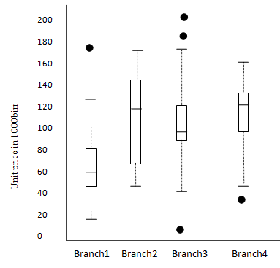
Descriptive data summarization
Box Plot
  Box Plots are popular way of visualizing a distribution which incorporate the five number summary as
  Boxplot for the unit price data for items sold at four branches

Slide 16
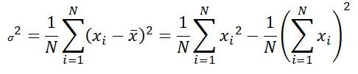
Descriptive data summarization
Variance and Standard deviation
  Variance can be computed as follows
  The basic properties of standard deviation (δ) are
    Measure spread about the mean and should be used if mean is chosen as a measure of central tendency
    δ =0 when there is spread (all data value are the same) otherwise δ >0
    Variance and δ are algebraic measures

Slide 17
Graphic display of basic descriptive summaries
The following are some of the graphical data presentations tools in statistics for the display of data summaries and distributions
  bar chart,
  pie chart,
  line graph
  Histograms
  Quantile plot
  q-q plots
  Scatter plot and
  Loess curves

Slide 18
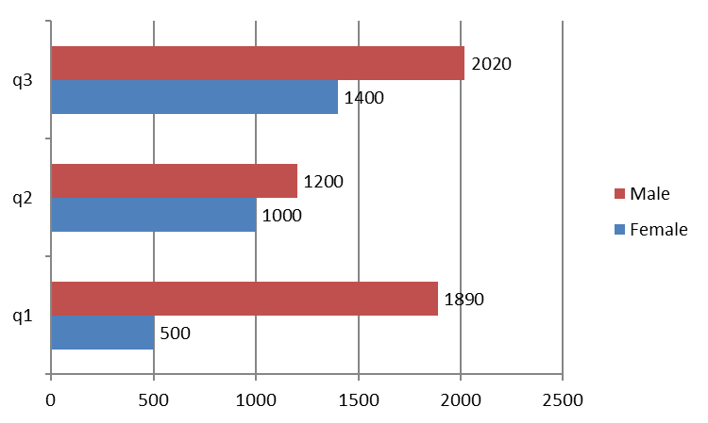
Graphic display of basic descriptive summaries
Bar chart
  It is a mechanism to compare and contrast individual variable using bars

Slide 19
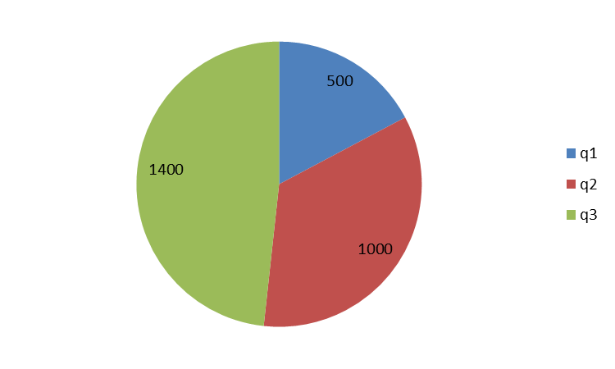
Graphic display of basic descriptive summaries
Pie chart
  It is a mechanism to compare and contrast individual variable using sectors of a circle. Area of the sector shows the proportion of the variable value

Slide 20
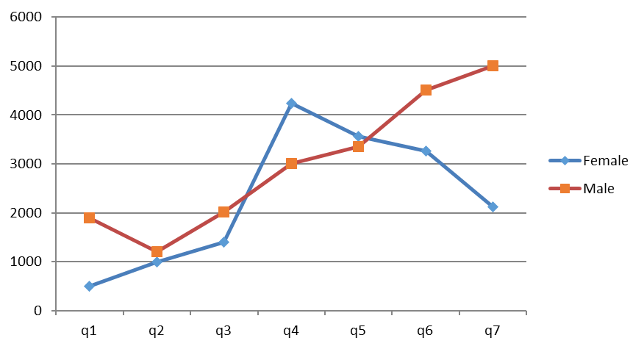
Graphic display of basic descriptive summaries
Line Graph
  It is a graph that show the relationship between two variables. It enable to show dependency of the variables and allows comparison of two or more variables as well

Slide 21
Graphic display of basic descriptive summaries
Histograms
  Is also called frequency histogram
  If data set is categorical like grade then one bar is drawn for each value (say A, B, C,D, F, NG, I) resulting a bar chart
  If data set is numeric, then different buckets should be created usually intervals of the same width and a bar shows the frequency of data values at each interval

Slide 22
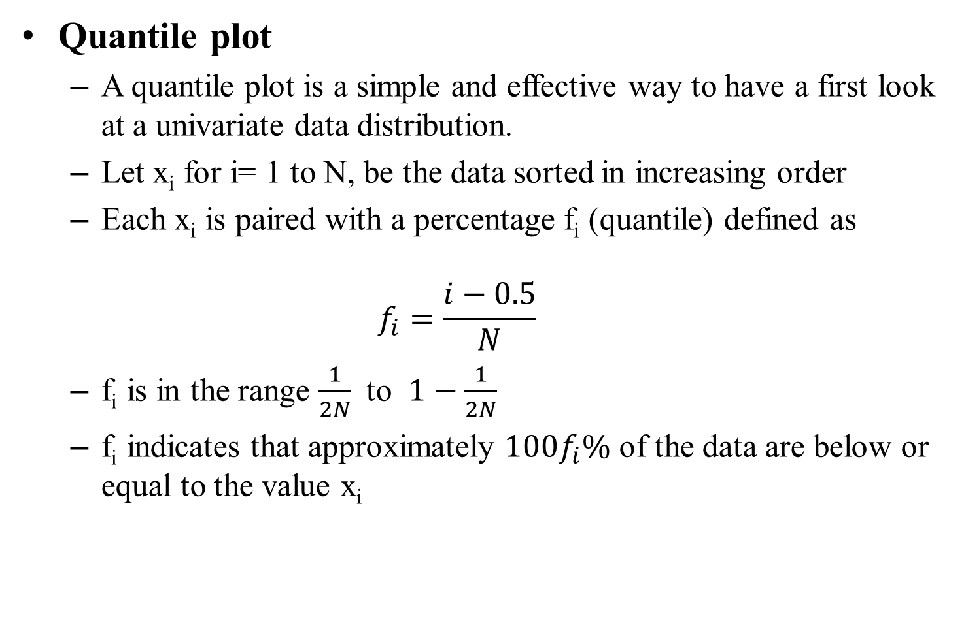
Graphic display of basic descriptive summaries

Slide 23
Graphic display of basic descriptive summaries
Quantile plot
  Quantile plot is a plots drawn for the data value x_{i} (Y-axis) against f_{i} (X-axis)
  it displays
    all of the data for the given attribute allowing the user to assess both the overall behavior and unusual occurrences
    it plots quantile information.
  Note 0.25, 0.5 and 0.75 quantiles corresponds to the quartiles Q1, Q2, and Q3 respectively

Slide 24
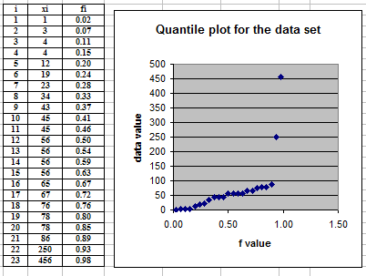
Graphic display of basic descriptive summaries
Quantile plot
  The following figure shows the data set and the quantile plot

Slide 25
Graphic display of basic descriptive summaries
q-q plots
  q-q (quantile-quantile) plot shows the plots of the quantile of one data set distribution against quantile of another distribution (say unit price at branch 1 against unit price at branch2)
  The X-Axis and Y-Axis shows the data values of the two distribution
  A point in the plot shows the pair of values having the same quantile (a point at (x_{i}, y_{j}) shows that x_{i} and y_{j} have the same quantile)
  This plot is powerful visualization tool in showing weather there is a shift in going from one distribution into another

Slide 26
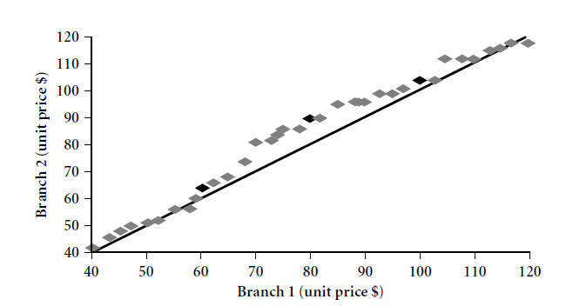
Graphic display of basic descriptive summaries
q-q plots
  Example
This point shows Q2 (0.5 quantile) of branch one and two are at value 80 and 90 respectively

Slide 27
Graphic display of basic descriptive summaries
Scatter plot
  Is one of the most effective graphical methods for determining if there appears a relationship, pattern or trend between two numeric attributes
  For example unit price versus amount of item sold
  A point in scatter plot indicate the relation between the data values on each axis as the number of items sold at that unit price
  If there is no relation between the attribute the plots will be uniformly scattered across the space otherwise there is some kind of relation

Slide 28
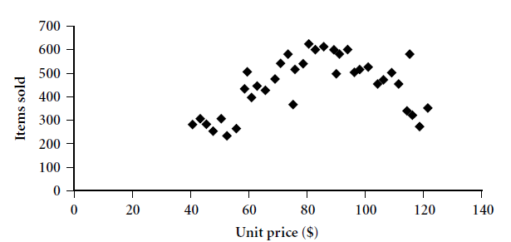
Graphic display of basic descriptive summaries
Scatter plot
  Example

Slide 29
Major Tasks in Data Preprocessing
Data pre-processing in data mining activity refers to the processing of data attributes and values to prepare for the mining operation.
Any activity performed prior to mining the data is called
pre-processing
This involves:
  Data cleaning
  Data integration
  Data transformation
  Data reduction
  Data Discretization and concept hierarchy generation

Slide 30
Major Tasks in Data Preprocessing
Data cleaning
  Fill in missing values, smooth noisy data, identify or remove outliers, and resolve inconsistencies
Data integration
  Integration of multiple databases, data cubes, or files (heterogeneous data sources)
Data transformation
  Normalization and aggregation ( as deemed necessary)
Data reduction
  Obtains reduced representation in volume but produces the same or similar analytical results. Very important for Big Data Analysis
Data discretization
  Data discritization refers to transforming the data set which is usually continuous into discrete interval values.
  Note: Reading Assignment: read the details of each data processing tasks

Slide 31
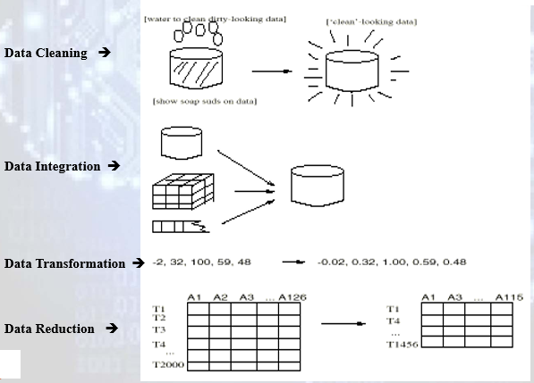
Forms of Data Preprocessing

Slide 32
How to Handle Missing Data
Ignore the tuple: usually done when class label is missing (assuming the tasks is classification—not effective when the percentage of missing values per attribute varies considerably.
Fill in the missing value manually: tedious and infeasible
Use a global constant to fill in the missing value: E.g., “unknown”, a new class?! Simple but not recommended as this constant may form some interesting pattern for the data mining task which mislead decision process

Slide 33
How to Handle Missing Data
Use the attribute mean: for all samples belonging to the same class to fill in the missing value with the class mean
Use the most probable value: fill in the missing values by predicting its value from correlation of the available values and values of other attributes through regression analysis, inference-based tools such as Bayesian formula or decision tree
Except the first two approach, the rest filled values are incorrect
The last two approaches are the most commonly used technique to fill missing data

Slide 34
Data Integration
Data integration:
  Combines data from multiple sources (databases, data cubes, or files) into a coherent store
There are a number of issues to consider during data integration
Some of these are
  Schema integration issue
  Entity identification issue
  Data value conflict issue
  Avoiding redundancy issue

Slide 35
Data Integration
Schema integration
  Schema refers to the design of an entity and its relation in the data source
  Integrate metadata from different sources
Entity identification problem:
  identify real world entities from multiple data sources which are identical so that they can be integrated properly
  As data source for data mining differ, the same entity will have different representation in the different sources
  Identical entities may have different representation of attribute naming in different sources

Slide 36
Data Integration
Data value conflict issue
  Involves detecting and resolving data value conflicts
  for the same real world entity, attribute values from different sources may be different
  possible reasons: different representations, different scales, measurement unit used

Slide 37

Data Integration
Avoiding redundancy issue
  Redundant data occur often during integration of multiple databases
    The same attribute may have different names in different databases
    One attribute may be a “derived” attribute in another table, e.g., annual revenue from monthly revenue
  Redundant data may be able to be detected by correlation analysis for numeric data

Slide 38
Data Integration
Avoiding redundancy issue
  The correlation between two attribute A and B (rA,B) is always in the range from -1 to +1.
  r_{A,B} = -1 is to mean negatively correlated, r_{A,B} = 0 to mean uncorrelated and r_{A,B} = +1 is perfectly correlated
  Careful integration of the data from multiple sources may help to reduce/avoid redundancies and inconsistencies and improve mining speed and quality

Slide 39
Data Transformation
  Data transformation is the process of transforming or consolidating data into a form appropriate for mining which is more appropriate for measurement of similarity and distance
This involves
  Smoothing
  Aggregation
  Generalization
  Normalization
  Attribute/feature construction

Slide 40
Data Transformation
Smoothing: concerned mainly to remove noise from data using techniques such as binning, clustering, and regression
Aggregation: summarization or aggregation operations are performed
Generalization: concept hierarchy climbing (from low level into higher level)

Slide 41
Data Transformation
Normalization: scaled to fall within a small, specified range
  Used mainly
    for classification algorithms such as neural network,
    distance measurements such as clustering, nearest neighbor approach
  Normalization exist in various forms
    min-max normalization
    z-score normalization
    normalization by decimal scaling
    Attribute/feature construction

Slide 42

Data Transformation: Normalization
min-max normalization
  Perform a linear transformation on the original data into a specified range of min and max value
MINA
v
MAXA
NEW_MINA
NEW_MAXA
v’

Slide 43
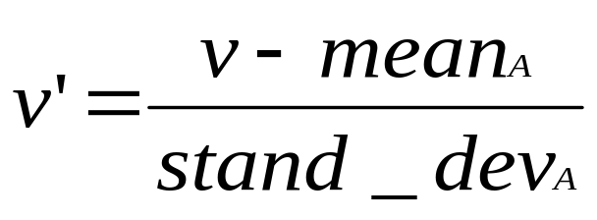
Data Transformation: Normalization
z-score (zero mean) normalization
  A value will be normalized based on the mean and standard deviation of the original data
  The transformed data will have zero mean value

Slide 44


Data Transformation: Normalization
Normalization by decimal scaling
  Normalizes by moving the decimal point of values of attribute A.
  The resulting value ranges from -1 to +1 exclusive
Where j is the smallest integer such that Max(| |)<1

Slide 45
Data Transformation: Normalization
Normalization by decimal scaling
Where j is the smallest integer such that Max(|v’|)<1
For example:
  given the data set V= 132, -89, 756, -1560, 234, -345 and 1234
  The value of v’ becomes in the range from -1 to +1 if j=10,000
  In that case V’ = 0.0132, -0.0089, 0.0756, -0.156, 0.0234, -0.0345, and 0.1234

Slide 46
Data Transformation: Attribute construction
  Attribute construction is the process of driving new attributes from the existing attributes.
Attribute construction is important to improve performance of data mining as the derived attribute will have more discriminative power than the base attributes
Enable to discover missing information or information hidden within the data set
For example area can be derived from width and height which may be more informative than any of the two or their combinations

Slide 47
Data Reduction
Warehouse may store terabytes of data
Complex data analysis/mining may take a very long time to run on the complete data set
Data reduction tries to obtain a reduced representation of the data set that is much smaller in volume but yet produces the same (or almost the same or better) analytical results

Slide 48
Data Reduction
Data reduction strategies includes
  Data cube aggregation
  Attribute subset selection
  Dimensionality reduction
    Huffman coding
    Wavelet transforms
    Principal component analysis
  Numerosity reduction
    Regression and log-linear models
    Histograms
    Clustering
    Sampling

Slide 49
Data reduction strategies: by Data Cube Aggregation
Data cube aggregation and using it for data mining task reduces the data set size significantly
For example, one can aggregate sales amount specified at each year and quarter into the sum of the sales amount per year
Multiple levels of aggregation in data cubes further reduce the size of data to deal with
One should select appropriate levels of aggregation
Use the most reduced representation which is sufficient to solve the task

Slide 50
  Data reduction strategies: by Attribute subset selection
Removes irrelevant attribute by attribute relevance analysis
Let us assume we have d set of attributes in the data set.
This set has 2^{d} sub sets of attributes and dimensionality reduction refers to selection of the subset which has the minimum number of elements in it and represent the pattern as close as possible with the original attributes
Hence attribute subset selection may refer one approach of dimensionality reduction

Slide 51
Data reduction strategies: by Attribute subset selection
Several heuristic for attribute subset (feature) selection exists
Four of them are:
  step-wise forward selection
  step-wise backward elimination
  combining forward selection and backward elimination
  decision-tree induction algorithm

Slide 52
Data reduction strategies: by Attribute subset selection
step-wise forward selection
  Start with empty set
  The best single-feature is picked first
  Then next best feature will be selected conditioned by the first, ...
  Stop when the selected feature set closely represent the entire features

Slide 53
Data reduction strategies: by Attribute subset selection
step-wise backward elimination
  Start with all the feature set elements
  The feature which is most irrelevant will be discarded first
  Then next most irrelevant feature will be discarded and repeated, ...
  Stop when removing the next candidate attribute for removal affects the pattern significantly

Slide 54
Data reduction strategies: By Attribute subset selection
combining forward selection and backward elimination
  At each step, the procedure selects the best feature and remove the most irrelevant
decision-tree induction algorithm
  This algorithm generate a decision tree using some of the attributes
  The attributes used in building the decision tree will be taken as attributes that represents closely the entire attributes

Slide 55
  Data reduction strategies: By Attribute subset selection
Example of Decision Tree Induction
Initial attribute set:
{A1, A2, A3, A4, A5, A6}
A4 ?
A1?
A6?
Class 1
Class 2
Class 1
Class 2
>
Reduced attribute set: {A1, A4, A6}

Slide 56
  Data reduction strategies: Dimensionality reduction
Tries to compress the data using encoding scheme such as
  minimum length encoding,
    Huffman Encoding
  wavelet encoding,
  principal component analysis, etc

Slide 57
Data reduction strategies: Dimensionality reduction
Compressed
Data
Original Data
Approximated
Original Data
compression
lossy
lossless

Slide 58
  Data reduction strategies: Dimensionality reduction
Compression can be made on data such as string, audio, and video
String compression
  There are extensive theories and well-tuned algorithms
  Typically lossless
  But only limited manipulation is possible without expansion
Wavelet transformation and principal component analysis are two of the most common dimension reduction approaches which are lossy

Slide 59
Data reduction : Huffman coding for dimension reduction
Huffman coding is an entropy encoding algorithm used for lossless data compression.
The term refers to the use of a variable-length code table for encoding a source symbol (such as a character in a file) where the variable-length code table has been derived in a particular way based on the estimated probability of occurrence for each possible value of the source symbol.

Slide 60
Data reduction : Huffman coding for dimension reduction
Given the data as:
“aaab babdbab abcb dbaeb ababd cbaab dbcaebf”
This data will be analyzed and may be the followed character set and their frequency will be generated
character | frquency
a | 12
b | 15
c | 3
d | 4
e | 2
f | 1
space | 6
Total | 43
This will require 43 byte in the normal circumstance

Slide 61
Data reduction : Huffman coding for dimension reduction
One possible compression is as shown in the table called Huffman coding
character | frquency | possible code | Total bit required
b | 15 | 0 | 15
1 | 12 | 10 | 24
space | 6 | 110 | 18
d | 4 | 1110 | 16
c | 3 | 11110 | 15
e | 2 | 111110 | 12
f | 1 | 111111 | 6
Total | 43 |  | 13.25
The above can be represented by replacing each character with the specified code which require a total of 106 bits (13.25 bytes)
This reduce the total memory requirement to 30.8%

Slide 62
Data reduction : Wavelet Transforms for dimension reduction
Discrete wavelet transform (DWT): linear signal processing
Compressed approximation: store only a small fraction of the strongest of the wavelet coefficients
Similar to discrete Fourier transform (DFT), but better lossy compression, localized in space
Link

Slide 63
Data reduction : Principal Component Analysis for dimension reduction
Given N data vectors from k-dimensions, find c <= k orthogonal vectors that can be best used to represent data
  The original data set is reduced to one consisting of N data vectors on c principal components (reduced dimensions)
Each data vector is a linear combination of the c principal component vectors
Works for numeric data only
Used when the number of dimensions is large

Slide 64
Data Compression: Principal Component Analysis for dimension reduction
X2
Y1
Y2
X1
Link

Slide 65
Data Reduction: Numerosity Reduction
Refers to replacing the data by alternatives representation which is smaller in size
This can be
  parametric or
  non-parametric methods

Slide 66
Data Reduction: Numerosity Reduction
Parametric methods
  Assume the data fits some model, estimate model parameters, store only the parameters, and discard the data (except possible outliers)
  Some examples include: Gaussian distribution, regression and log-linear models

Slide 67
Data Reduction: Numerosity Reduction
Non-parametric methods
  Do not assume models
  Find alternate smaller representation and discard the data
  Major families: histograms, clustering, sampling

Slide 68
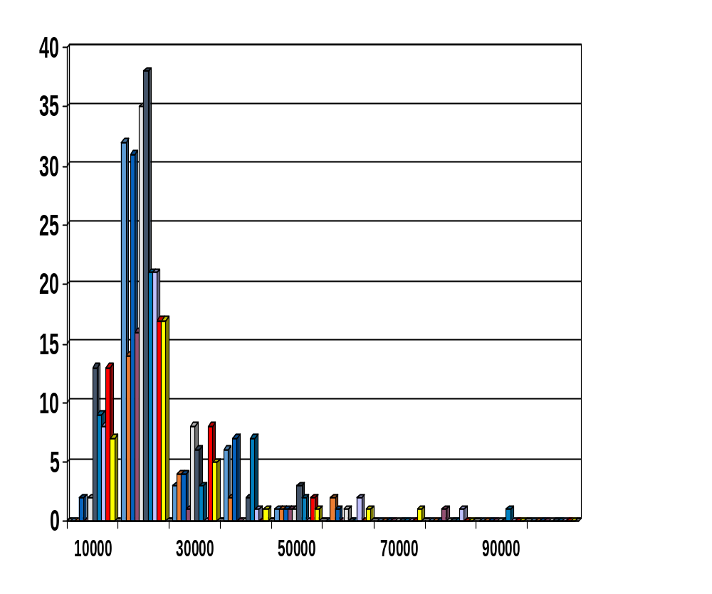
Data Reduction: Numerosity Reduction using Histograms
A popular data reduction technique
Divide data into buckets and store average or count or sum for each bucket
Can be constructed optimally in one dimension using dynamic programming

Slide 69
Data Reduction: Numerosity Reduction using Histograms
There exist different types of histogram
  Equiwidth
  Equidepth
  V-Optimal (Variance-Optimal)
  MaxDiff

Slide 70
Data Reduction: Numerosity Reduction using Histograms
Equiwidth histogram
  the width of each bucket is set to be the same (say in the interval from i to i+10 for the ith bucket)
Equidepth Histogram
  each bucket will have variable width but the roughly same number of items in them

Slide 71
Data Reduction: Numerosity Reduction using Histograms
V-Optimal
  Given the number of buckets needs to be formed, there are many alternative histograms for a given data set by setting the bin boundaries
  Among the possible buckets V-Optimal histogram is the one with the least variance
  Variance of histogram is a weighted sum of the original values (bin boundaries) that each bucket represents
  The weight is equals to the number of items/values in the buckets

Slide 72
Data Reduction: Numerosity Reduction using Histograms
V-Optimal (steps given number of histogram = N)
  For each possible N-1 bucket boundaries
    Form the N buckets using the bucket boundaries
    Add values of each bucket and multiply by the number of items the bucket has
    Add the values obtained for each buckets (call it sum_i) where i is unique reference for the bucket boundaries
  Choose the bucket boundaries that results in the smallest sum_i value

Slide 73
Data Reduction: Numerosity Reduction using Histograms
MaxDiff
  Procedure:
    attribute values will be sorted first
    Attribute values difference will be computed
    Selected the largest N-1 attribute differences
    Those attribute value pairs that gives the N-1 attribute differences will be taken as bucket boundaries

Slide 74
Data Reduction: Numerosity Reduction using Clustering
Partition data set into clusters, and one can store cluster representation only (cluster index)
Can be very effective if data can be organized into distinct clusters but not effective if data is “smeared”
Can have hierarchical clustering and be stored in multi-dimensional index tree structures like B+ tree
There are many choices of clustering definitions and clustering algorithms, further detailed will be given later

Slide 75
Data Reduction: Numerosity Reduction using sampling
Sampling can be used as a data reduction technique because it allows a large data set to be represented by a much smaller sample (or subset) of the data.
Different types of sampling exists
  Simple random sampling without replacement
  Simple random sampling with replacement
  Cluster sampling (do sampling on cluster, choose m clusters out of the N)
  Stratified sampling (do simple random sampling on each cluster)

Slide 76
Data Reduction: Numerosity Reduction using sampling
Simple random sampling may have very poor performance for skewed dataset
Stratified sampling need to approximate the percentage of each class (or subpopulation of interest) in the overall database
  Appropriate for data which are skewed

Slide 77
Data Reduction: Numerosity Reduction using sampling
SRSWOR
(simple random
sample without
replacement)
SRSWR
(simple random
sample with
replacement)
Raw Data

Slide 78
Data Reduction: Numerosity Reduction using sampling
Raw Data
Stratified Sampling
Cluster Sampling

Slide 79
Data Reduction: Numerosity Reduction
Parametric methods
  Assume some model to fit into the data distribution
  Find alternate smaller representation and discard the data (values of the parameters that define the model)
Major families: Linear regression model, Multiple regression model, Log-linear regression model

Slide 80
Data Reduction: Numerosity Reduction using Regression and Log-Linear Models
Linear regression:
  Data are modeled to fit a straight line
  Often uses the least-square error method to fit the line
  Y = mX + b (m and b are the parameters; both are scalar values)
Multiple regression:
  allows a response variable Y to be modeled as a linear function of multidimensional feature vector
  Y = mX + b (m and b are the parameters; both are vectors values)

Slide 81
Data Reduction: Numerosity Reduction using Regression and Log-Linear Models
Log-linear model:
  approximates discrete multidimensional probability distributions using log function

Slide 82
Data Discretization and concept hierarchy generation
Data discritization refers to transforming the data set which is usually continous into discrete interval values
Concept hierarchy refers to generating the concept levels so that data mining function can be applied at specific concept level
Data discretization techniques can be used to reduce the number of values for a given continuous attribute by dividing the range of attribute into intervals
Interval labels can be used to replace actual data values
This leads to concise, easy to use, knowledge level representation of mining result

Slide 83
Data Discretization and concept hierarchy generation
Discretization:
  Divide the range of a continuous attribute into intervals
  Reduce data size by discretization
  Prepare data for further analysis
  Some classification algorithms only accept categorical attributes and hence numeric attribute require discretization.
Concept hierarchies
  Reduce the data by collecting and replacing low level concepts (such as measure of all the days for the attribute time) by higher level concepts (such as measure of all the weeks that reduce the data from N tuples to N/7 tuple).
  Concept hierarchy generation refers to finding hierarchical relation in the data set and build the concept hierarchy automatically

Slide 84
Dataset preparation for Classification
Proper procedure in some classification system development involves three sets of data :
  training data:
    Data used for parameter adjustment
  validation data:
    Data used for goodness of the model to decide next round re-estimation or not
    Validation data is used to optimize parameters which is optional in some other systems
    It is optional
  test data:
    Data used for measuring the final performance of the system for reporting

Slide 85
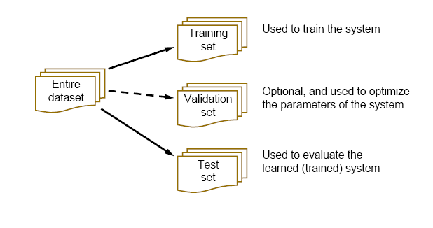
Dataset preparation for Classification

Slide 86
Dataset preparation for Classification
Once evaluation is complete, all the data can be used to build the final classifier
Generally, the larger the training data the better the classifier (but returns diminish)
The larger the test data the more accurate the error estimate

Slide 87

Building Classification Model
Results Known
+
Model
Builder
+
Training set
-
-
Data
+
Evaluate
Model Builder
Predictions
+
-
+
-
Y
N
Validation set
+
-
+
-
Final Evaluation
Final Test Set
Final Model

Slide 88
Building Classification Model: Parameter tuning
Some learning schemes operate in two stages:
  Stage 1: builds the basic structure
  Stage 2: optimizes parameter settings
Optimizing the parameter setting refers to adjusting important parameters to maximize the performance of the system
The test data can’t be used for parameter tuning!

Slide 89
Unbalanced data
Sometimes, classes have very unequal frequency
  medical diagnosis: 90% healthy, 10% disease
  eCommerce: 99% don’t buy, 1% buy
  Security: >99.99% of Americans are not terrorists
Majority class classifier can be 97% correct, but useless
If we have two classes that are very unbalanced, then it will be a bias to evaluate our classifier method

Slide 90
Balancing unbalanced data
With two or more classes, a good approach to make a balance between the class instances is to build BALANCED train and test sets
Approach
  randomly select desired number of minority class instances
  add equal number of randomly selected majority class
  Stratified sample: advanced version of balancing the data
    Make sure that each class is represented with approximately equal proportions in both subsets
  Then train the model on a balanced set
  It is important that the test data is not used in any way to create the classifier

Slide 91
Dataset size
Before we start building Classification model, we should check how good is the size of the dataset we have
Given balanced dataset, the next most important aspect of goodness is size of the data set
The model should be able to converge during learning the parameters from the dataset
If not, appropriate measure should be taken and care must be given while reporting performance
We will see learning curve analysis that best suit to detect goodness of the size of the training dataset

Slide 92
Learning Curve
Dataset Size
Learning curve is one of the measure of how well the training data converge to a point of maximum performance.
It is one of the most important tool to indicate whether the data set is sufficiently large or not
If it is sufficiently large, them we can model our system and tune parameters and start evaluating the system
If it is small, we should
  Design a means to get more data or
  We should modify the way how to measure performance

Slide 93
Learning Curve
Dataset Size
test accuracy
number of training examples

Slide 94
Dataset Size
What to do with small data?
Having small data but balanced can be approached in different ways to relay on the performance
Note that the total data set we have will be divided into three for training, testing and validation
The following are the techniques to minimize the effect of the dataset size
  Using Repeated holdout data for testing
  Using k-fold cross validation
  Using Leave-One-Out cross-validation

Slide 95
Dataset Size
What to do with small data: Using repeated holdout data
The holdout method reserves a certain amount for testing and uses the remainder for training and start to evaluate the system
  Usually: one third for testing, the rest for training
For “unbalanced” datasets, samples might not be representative
  Few or none instances of some classes
What if we have a small data set?
  The chosen 2/3 for training may not be representative.
  The chosen 1/3 for testing may not be representative.

Slide 96
Dataset Size
What to do with small data: Using repeated holdout data
Holdout estimate can be made more reliable by repeating the process with different subsamples
  In each iteration, a certain proportion is randomly selected for training (possibly with stratification)
  The error rates on the different iterations are averaged to yield an overall error rate
Still not optimum: the different test sets overlap.
Can we prevent overlapping?
  Yes which lead into the k-fold cross validation technique

Slide 97
Dataset Size
What to do with small data: Using K-fold cross validation
Cross-validation avoids overlapping test sets
  First step: data is split into k subsets of equal size
  Second step: each subset in turn is used for testing and the remainder for training
This is called k-fold cross-validation
Often the subsets are stratified before the cross-validation is performed
The error estimates are averaged to yield an overall error estimate

Slide 98
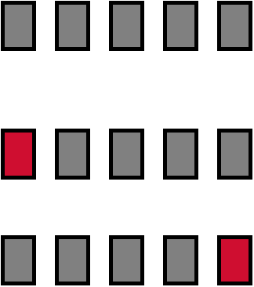
Dataset Size
What to do with small data: Using K-fold cross validation
example:
Break up data into groups of the same size
Hold aside one group for testing and use the rest to build model
Repeat
Test

Slide 99
Dataset Size
What to do with small data: Using K-fold cross validation
Standard method for evaluation: stratified ten-fold cross-validation
Why ten?
Extensive experiments have shown that this is the best choice to get an accurate estimate
Stratification reduces the estimate’s variance
Even better: repeated stratified cross-validation
  E.g. ten-fold cross-validation is repeated ten times and results are averaged (reduces the variance)

Slide 100
Dataset Size
What to do with small data: Leave-One-Out cross validation
Leave-One-Out:
a particular form of cross-validation:
  Set number of folds to number of training instances
  I.e., for n training instances, build classifier n times
Makes best use of the data
Involves no random sub sampling
Very computationally expensive
No stratification on test set as it has only one sample

